Slide 1
Estrous Synchronization

Slide 2
Estrous Synchronization
A management technique that makes use of hormones to control or reschedule the estrous cycle
Hormones associated with reproduction
LH & FSH
Progesterone
Estrogen
Prostaglandin

Slide 3
Why synchronize?
Group females for parturition (calving interval)
Shorten breeding season
Reduce estrus detection

Slide 4
Advantages of implementing a synchronization program
Calves produced early in season will wean heavier because they are older
Cows require 40-60 days to recover from calving before next breeding
Cows that bred earlier have better chance of maintaining 365 d calving interval the next year

Slide 5
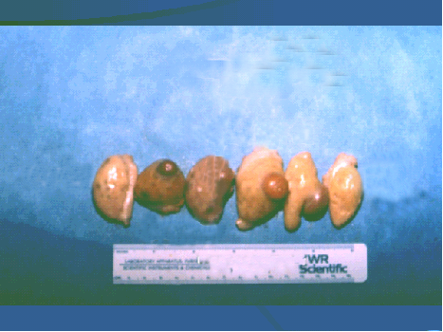
Basis for Synchronization of Estrus
Manipulate life span of CL
Manipulate growth of follicles and timing of ovulation

Slide 6
Synchronization Methods
Method | Tradename | Utilization
Gonadotropins | Cystorelin Fertagyl | Mature females
Prostaglandins | Estrumate Lutalyse Prostamate | Cycling females
Progestins | MGA CIDR | Pre-pubertal heifers Post-partum or Anestrous females

Slide 7
Synchronization Methods
Gonadotropins(GnRH protocols)
Naturally occurring hormone that stimulates the release of LH and FSH that stimulates follicular development
Protocols include Ovsynch and Cosynch

Slide 8
Synchronization methods
Prostaglandins
Naturally occurring hormone that causes regression of the CL (luteolysis) and decreases progesterone secretion which results in a return to estrus
Can expect estrus within two days following injection
Protocols include PGF one-shot method and PGF two-shot method

Slide 9
Synchronization methods
Progestins
Form of progesterone that extends the period of time progesterone is present and prevents animal from coming into heat
Protocols include MGA+prostaglandin and CIDR

Slide 10
Synchronization methods: drug trade names and effectiveness
Method | Trade name | Female “type” for drug effectiveness
Prostaglandins | Lutalyse* Estrumate* Prostamate* Equimate∞ | *Cycling cows or heifers ∞Cycling mares
Progestins | MGA* CIDR* Regumate∞ | *Cycling cows or heifers *Anestrous cows or heifers ∞Mares
* Cattle ∞Equine ^Swine

Slide 11
Synchronization methods: drug trade names and effectiveness
Method | Trade name | Female “Type” for drug effectiveness
Gonadotropin Releasing Hormones | Cystorelin* Fertagyl* Ovuplant∞ | *Postpartum cows *Anestrous cows ∞Cycling mares
Placental Gonadotropins | PG600^ | ^Peri-pubertal gilts
* Cattle ∞Equine ^Swine

Slide 12
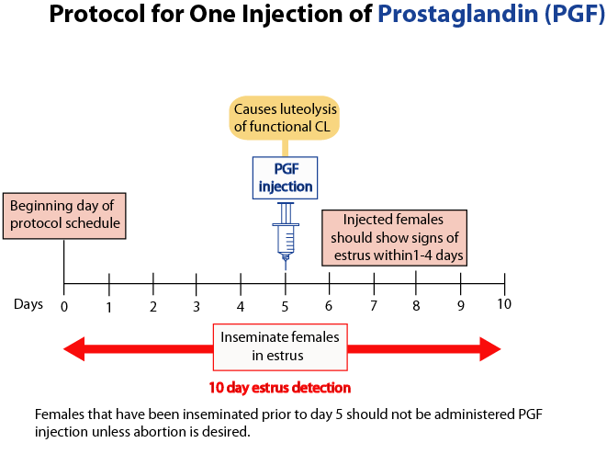

Slide 13
One Injection of PGF
Advantages
Useful for detection of estrus in heifers and cows
Decreased drug cost
Limited animal handling
Limitations
10-25% of females may not be detected in estrus during days 0 to 10
Poor degree of synchrony on females that return to estrus
Must have CL
Length of estrus detection
Abortion

Slide 14
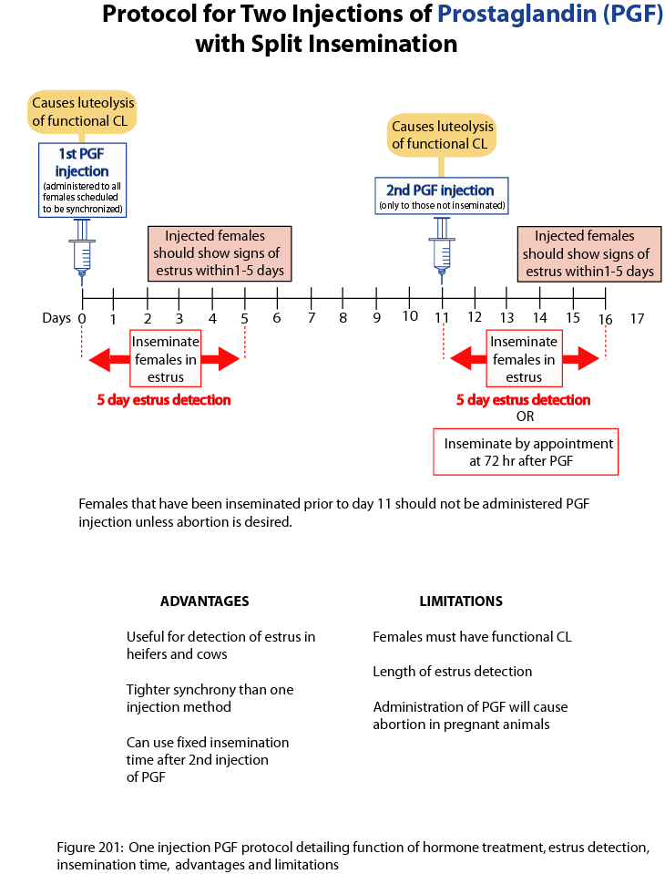

Slide 15
Two Injections of PGF
Advantages
Useful for detection of estrus in heifers and cows
Tighter synchrony than one injection method
Can use fixed insemination time after 2nd injection
Limitations
Females must have functional CL
Length of estrus detection
Administration of PGF will cause abortion in pregnant animals

Slide 16
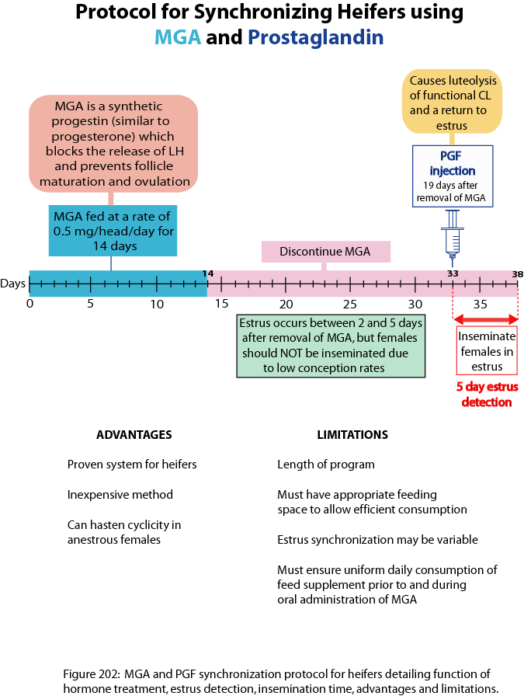

Slide 17
MGA and Prostaglandin
Advantages
Proven system for heifers
Inexpensive method
Can hasten cyclicity in anestrous females
Limitations
Length of program
Must have appropriate feeding space to allow efficient consumption
Estrus synchronization may be variable
Must ensure uniform daily consumption of feed supplement prior to and during oral administration of MGA

Slide 18
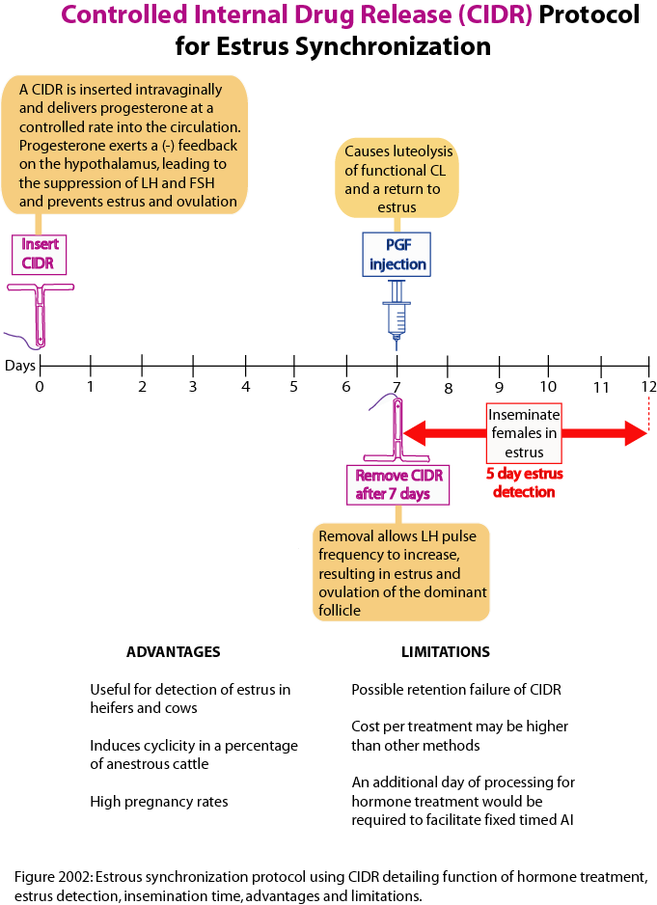

Slide 19
CIDR
Advantages
Useful for detection of estrus in heifers and cows
Induces cyclicity in a percentage of anestrous cattle
High pregnancy rates
Limitations
Possible retention failure of CIDR
Cost per treatment may be higher than other methods
An additional day of processing for hormone treatment would be required to facilitate fixed time AI

Slide 20
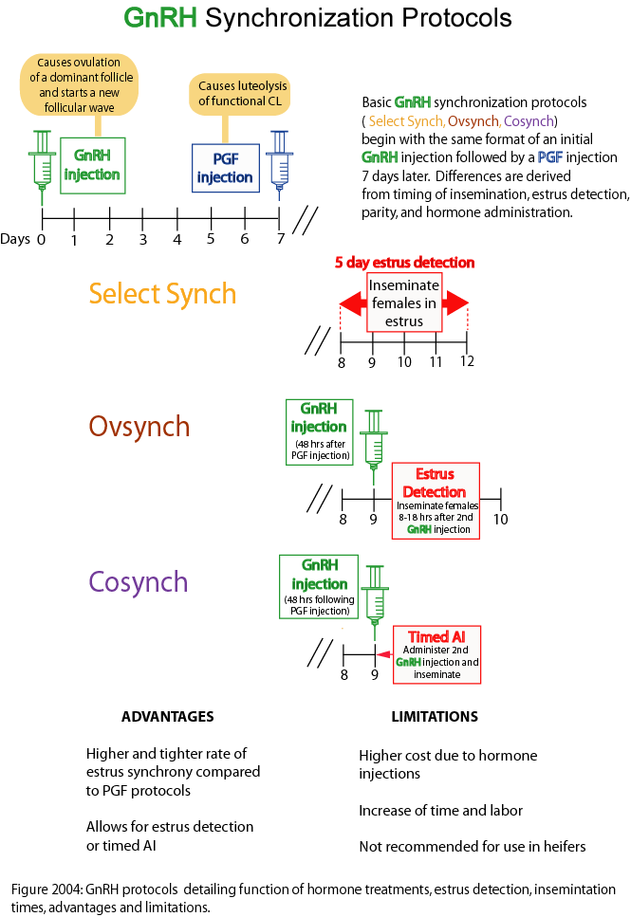

Slide 21
GnRH
Advantages
Higher and tighter rate of estrus synchrony compared to PGF protocols
Allows for estrus detection or timed AI
Limitations
Higher cost due to hormone injections
Increase of time and labor
Not recommended for use in heifers

Slide 22
Synchronization in the Mare
Products used: Equimate, Estrumate, Lutalyse
When administered in diestrus, expect ovulation in 7-12 days
If 30-35mm follicle is present, expect ovulation in 2-4 days
Will only work when fully functional CL is present
“short cycling” refers to restarting the estrous cycle early
Prostaglandin should be given after day 6
hCG can be given to mares resulting in immediate ovulation

Slide 23
Synchronization in the Sow
Prostaglandin will not cause CL regression until day 12 of cycle because LH binds to luteal cell receptor with strong affinity following ovulation and is not released until day 12. Repeated injections over two to three days will regress CL sooner, but is not practical.
Common progestins will synchronize estrus but cause ovarian cysts
Regumate has been found to be effective
Noncycling gilts can be synchronized with P.G. 600 (400 IU eCG and 200 IU hCG)

Slide 24
Synchronization in the Ewe
Most common protocols use either use prostaglandins or CIDR

